Slide 1

ONLINE RECIPE BOOK
CSI1007 – Software Engineering Principles Laboratory
23MIC0020
P. Ganesh Prakadesh

Slide 2
ONLINE RECIPE BOOK [ORB]
Description of the Project: Web – based platform that allows users to store, organize and share their favorite recipes. The system enables users to create an annount, add personalized recipes with ingredients, instructions and categorize them for easy access
Scope of the Project: It enables user login and authentication.
Focuses on recipe management
Enhanced search features
Save recipes for easy access

Slide 3
ONLINE RECIPE BOOK [ORB]
Impact of the developing project: - Accessibility and convenience: Users can access their recipes anytime, anywhere
- Culinary Exploration: Helps users discover diverse recipes and improve cooking skills
- Organization: Users get access to a sorted list of recipes according to their preferred cuisine

Slide 4
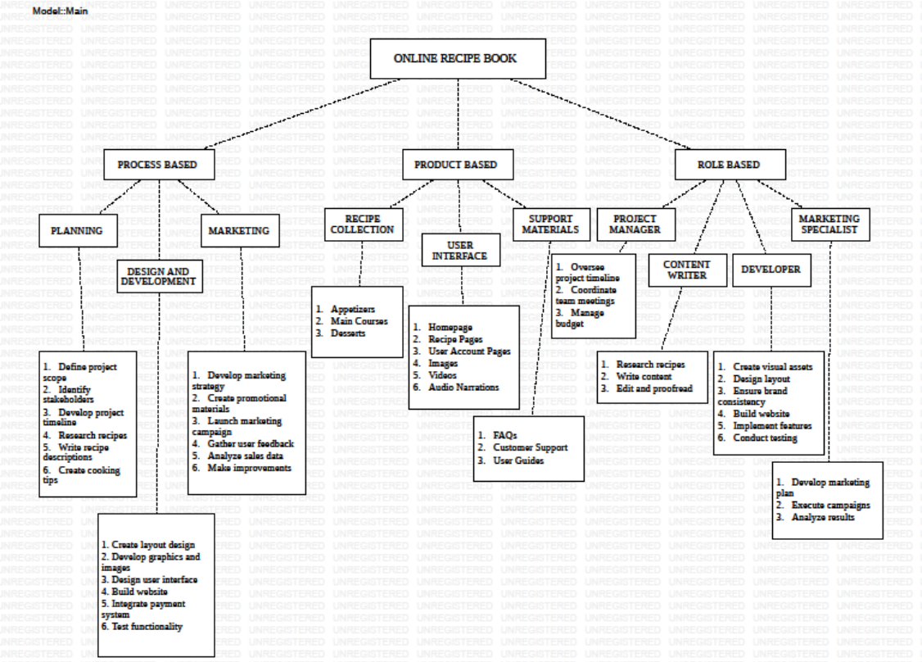
Work Breakdown Structure

Slide 5
SRS Document
FUNCTIONAL REQUIREMENTS:
User registration and login
Recipe browsing, filtering, and searching
User-generated recipe submissions
Ability to save recipes
Ability to access categorized recipes
NON-FUNCTIONAL REQUIREMENTS:
Handle 500 recipe uploads per second
Prevent unauthorized access to user-uploaded content
Encrypt user credentials and sensitive data
Ensure easy navigation and clear instructions.

Slide 6
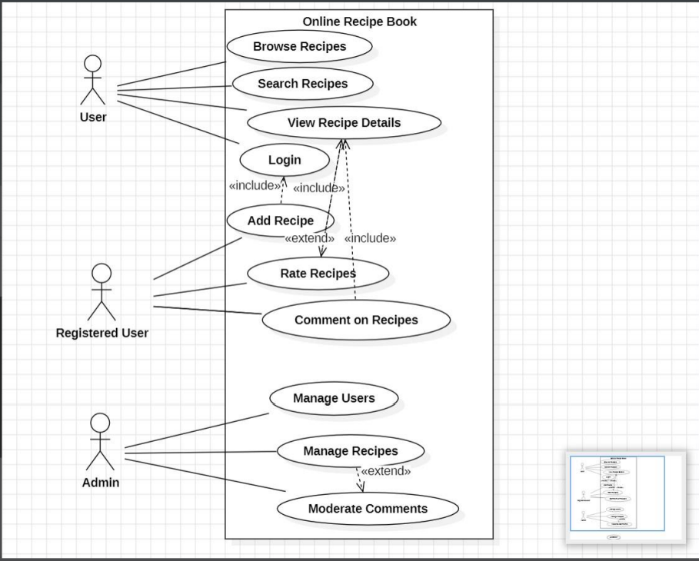
UML - Diagrams
USE – CASE DIAGRAM

Slide 7
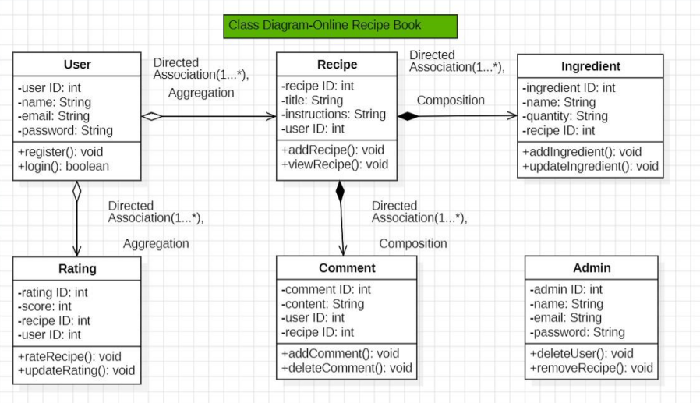
UML - Diagrams
CLASS DIAGRAM

Slide 8
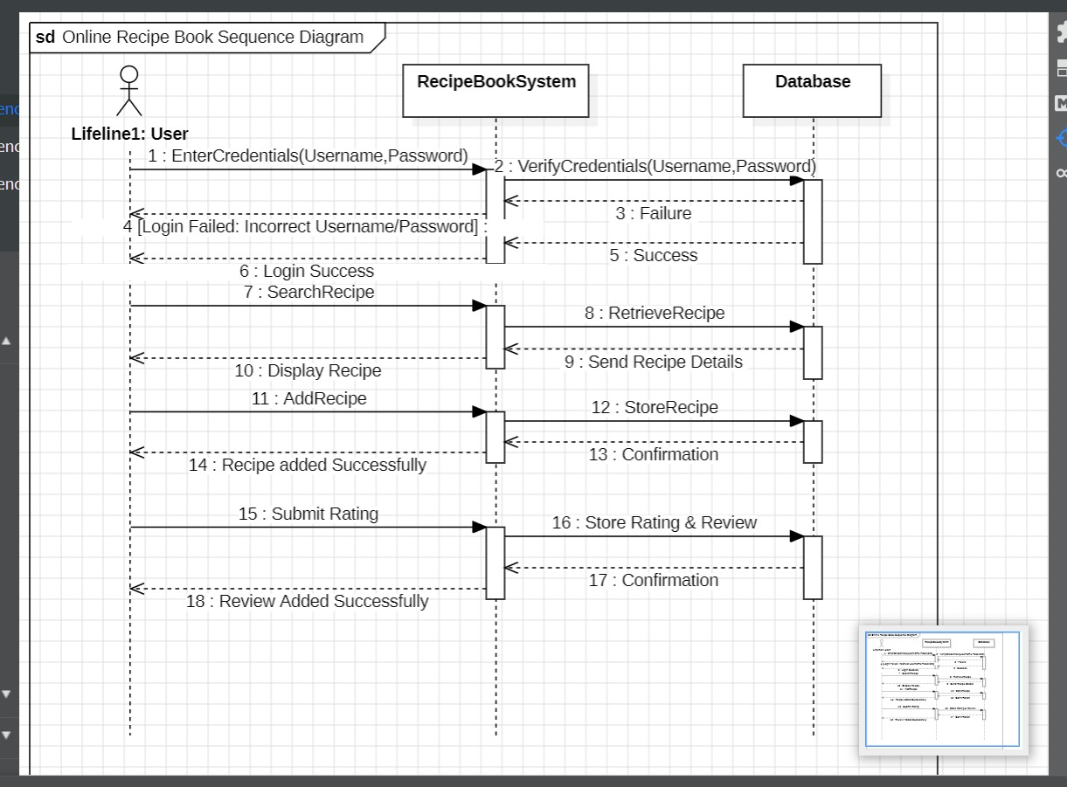
UML - Diagrams
SEQUENCE DIAGRAM

Slide 9
Testing
Test Data:
Username: user
Password: password
Expected Result:
Redirection to the home page
Actual Result:
Redirected to home page.
Pass/Fail:
Pass

Slide 10
Testing
Test Case 2: Searching for a Recipe
Test Case ID: ORB002
Test Scenario: Verify the recipe search functionality
Test Description: Enter a recipe name in the search bar and check if relevant results are displayed
Test Steps:
1. Open the Recipe Book homepage
2. Enter "Chocolate Cake" in the search bar
3. Verify if the correct results appear
Test Data:
Search Query: “Sushi”
Expected Result:
The search results should include “Sushi”

Slide 11
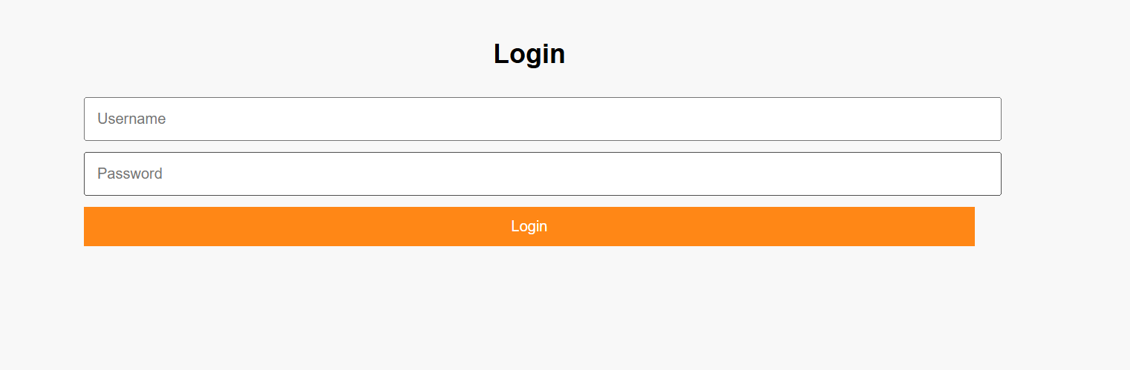
Project – UI Screenshots

Slide 12
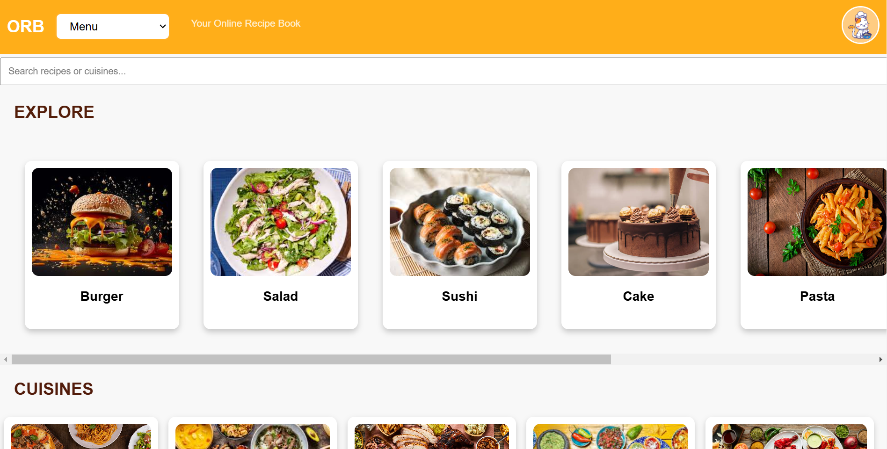
Project – UI Screenshots

Slide 13
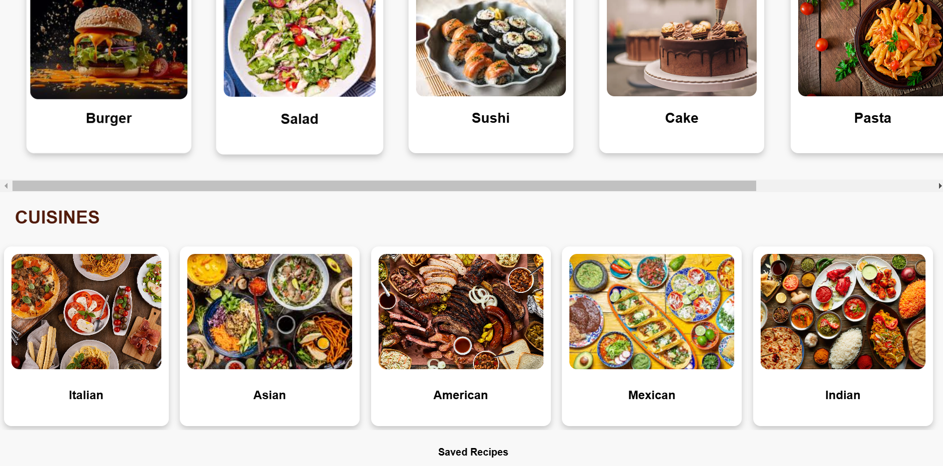
Project – UI Screenshots

Slide 14
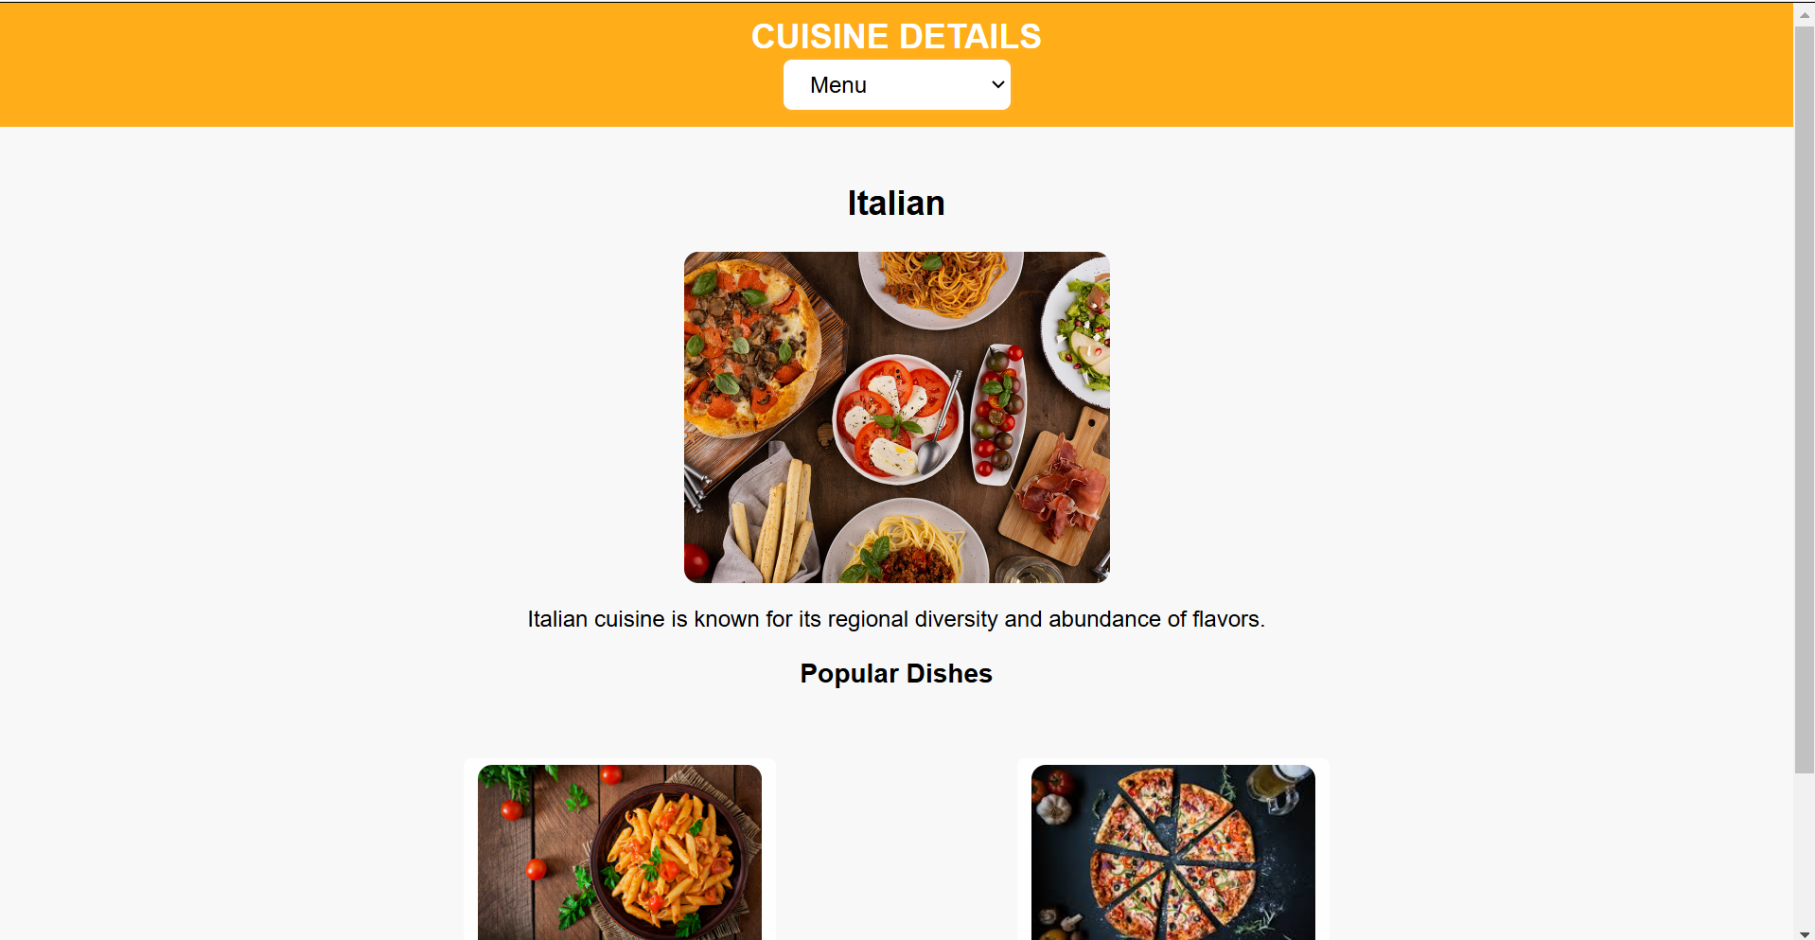
Project – UI Screenshots

Slide 15
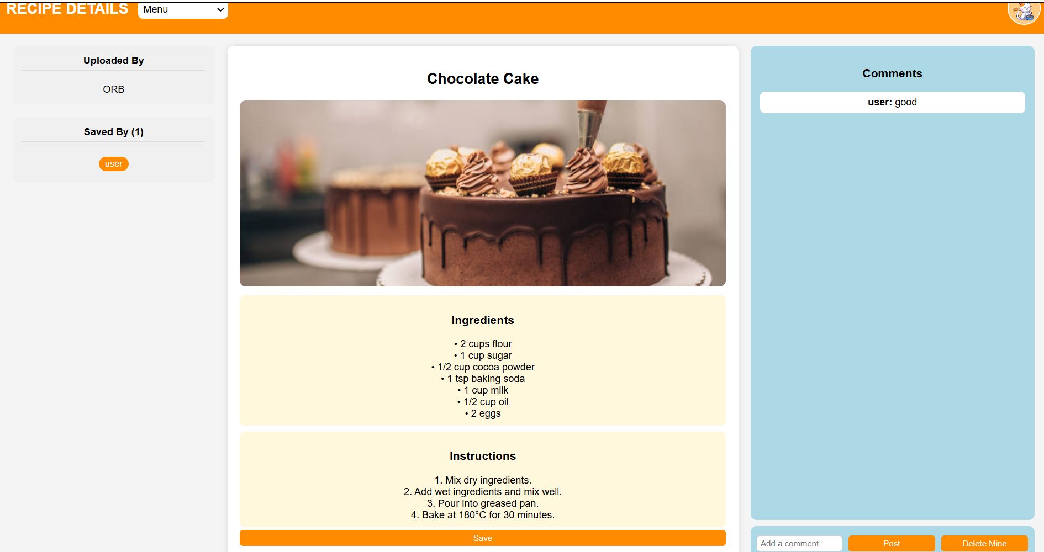
Project – UI Screenshots

Slide 16
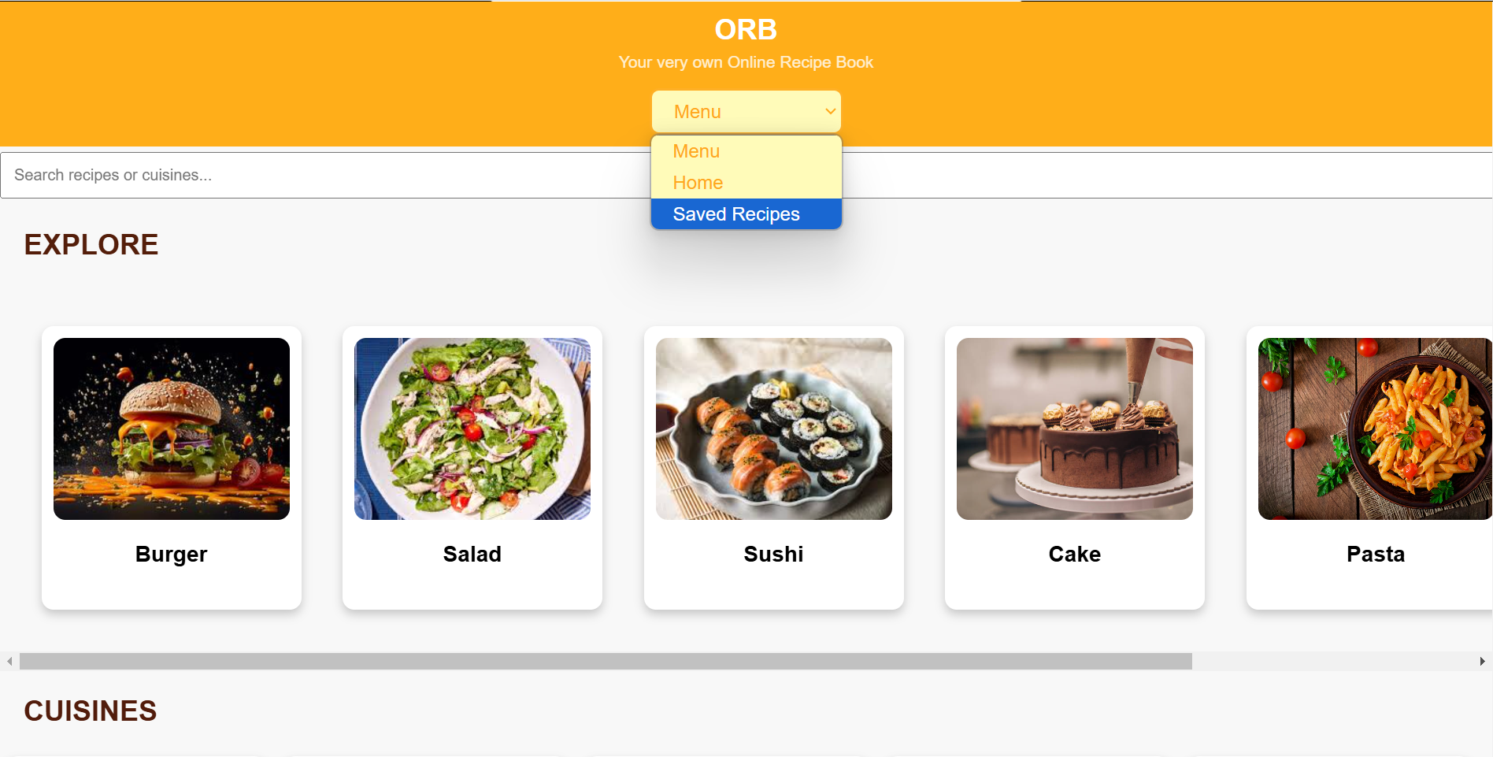
Project – UI Screenshots

Slide 17
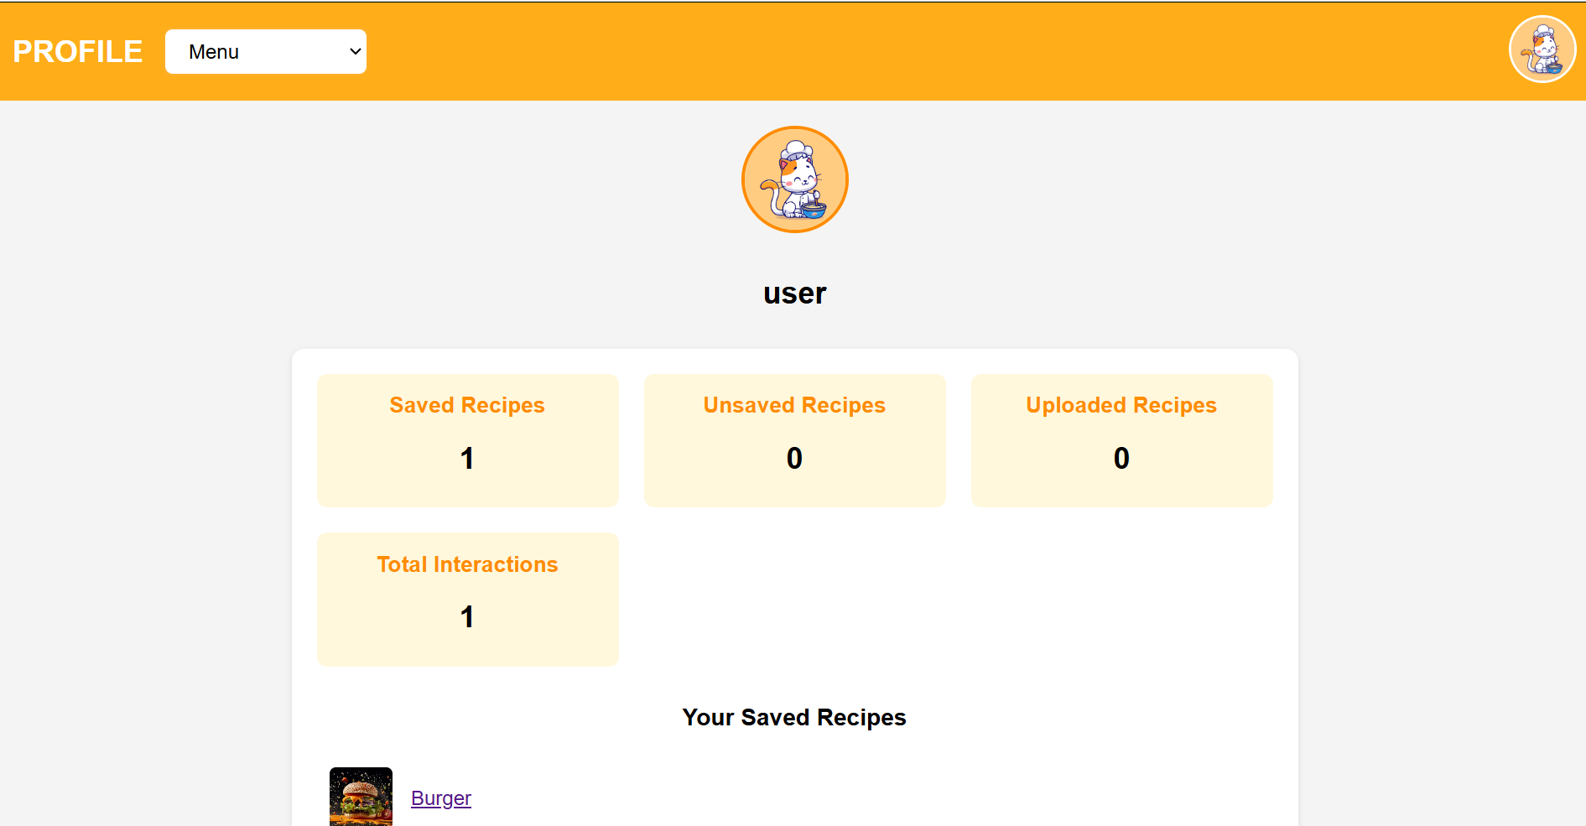
Project – UI Screenshots

